Slide 1
JDBC & Oracle DB

Slide 2
Goals and Non-Goals of the Tutorial
Discuss the given (simplified!) example code
Discuss the DB-Connection
In this Tutorial we will not discuss:
Object-oriented Programming
Reading files with JAVA
Java installations,…

Slide 3
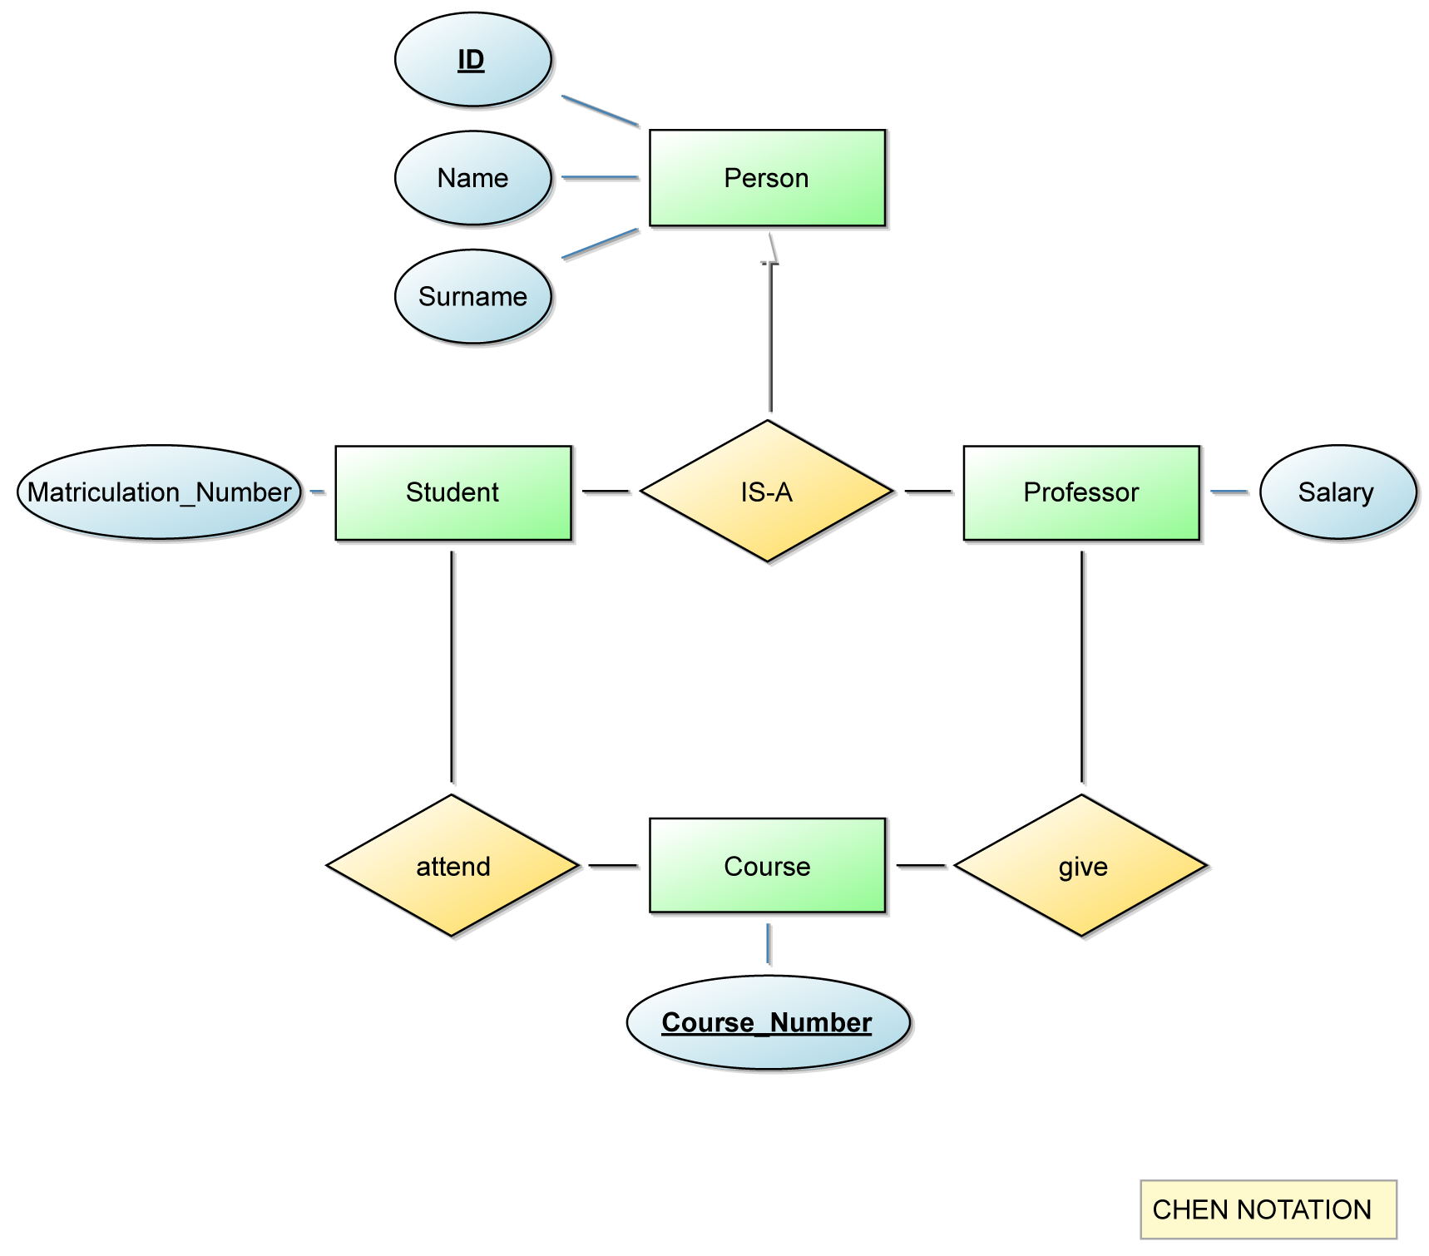
ER Model

Slide 4
Step 1:
Execute Create Table Statements

Slide 5
JDBC
Imports:
import java.sql.*;
Step 2:
Create Java Project and Import the JDBC Driver

Slide 6
Next Steps
1.Load a JDBC driver
2.Establish connection to DBMS
3.Create query
4.Execute query
5.Process result
6.Close connection to DBMS

Slide 7
JDBC
Imports:
DB connection:
import java.sql.*;
String dburl = "jdbc:oracle:thin:@oracle-lab.cs.univie.ac.at:1521:lab";
Connection con = DriverManager.getConnection(dburl, "name", "pwd");
Step 3:
Establish Connection to DB

Slide 8
Next Steps
1.Load a JDBC driver
2.Establish connection to DBMS
3.Create query
4.Execute query
5.Process result
6.Close connection to DBMS

Slide 9
JDBC (continued)
SQL query:
Get entries of result set with rs.next()
Statement stmt = con.createStatement(); String personen = "SELECT * FROM person"; ResultSet rs = stmt.executeQuery(personen);
while (rs.next()) {
String pers = rs.getString("name"); System.out.println(pers + " " + rs.getString("surname")); }
Step 4:
Create and Execute Statement

Slide 10
JDBC (continued)
Close connection:
rs.close(); stmt.close(); con.close();

Slide 11
JAVA App design
DataGenerator.java
Contains only 1 Method => main() => starting point
DatabaseHelper.java
Encapsulates communication with database
Creates and closes connection
Provides methods for INSERT and SELECT

Slide 12
Extension Points
Different Design (given Code is a simplification)
Create Tables if not existing
Delete Table function
Avoid violations on application layer (e.g. unique constraint errors)
Precompiled Statements + Host-Variables
Exception Handling
ID Handling (no fixed counters)
…

